Slide 1
Predictive Analytics & Machine learning in python

Slide 2
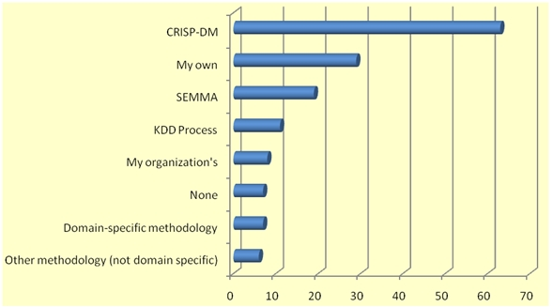
Data Mining Process
Systematic approach to carry out a data mining project that maximizes the chance of success.
Various standardized processes based on best practices:
CRISP-DM (Cross-Industry Standard Process for Data Mining)
SEMMA (Sample, Explore, Modify, Model, and Assess)
KDD (Knowledge Discovery in Databases)
Source: KDNuggets.com, August 2007

Slide 3
CRISP-DM
Proposed by a consortium of European companies in the mid-1990s as a nonproprietary standard.
Consists of a sequence of six steps:
The steps are sequential in nature but usually involve backtracking.
Whole process is iterative and could be time consuming.
The outcome from each step feeds into the next step and thus each step must be carefully conducted.
Data mining is largely driven by experience and experimentation – Is it an art or science?

Slide 4
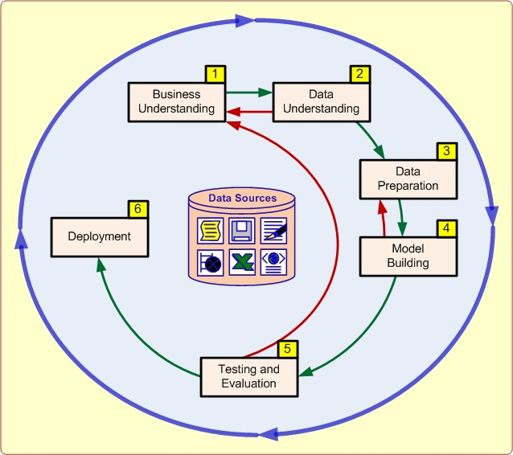
CRISP-DM (cont.)

Slide 5

Step 1 – Business Understanding
Know the purpose of the data mining study:
Thorough understanding of managerial need for new knowledge.
Explicit specification of the business objective.
Examples of specific business questions:
What are the common characteristics of the customers we have lost to our competitors recently?
What are typical profiles of our customers, and how much value does each of them provide to us?

Slide 6
Step 2 – Data Understanding
Identify the relevant data from many available data sources – internal databases and external sources.
Key consideration factors in identifying and selecting data:
Clear and concise description of data mining task.
Develop an in-depth understanding of the data and variables:
Is there any synonymous and/or homonymous variables.
Are the variables independent of each other?
Use different techniques to help understand data:
Statistical techniques: Statistical summaries and correlation analysis.
Graphical techniques: Scatter plots, histograms and box plots.

Slide 7
Step 2 – Data Understanding (cont.)
Common data sources:
Demographic data – E.g., income, education, number of households and age.
Sociographic data – E.g., hobby, club membership and entertainment.
Transactional data – Sales record, credit card spending and issued checks.

Slide 8
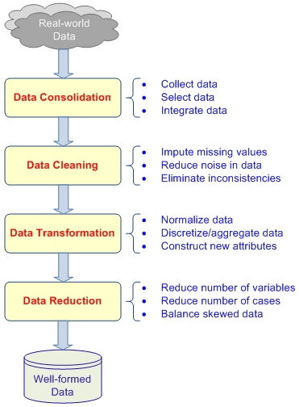
Step 3 – Data Preparation

Slide 9
Step 3 – Data Preparation (cont.)
Prepare the data identified in Step 2 for data mining analysis,, i.e., data preprocessing.
Consumes the most time and effort, roughly 80% of total.
Four main steps to convert raw, real-world data into minable datasets.
Data consolidation:
Relevant data are collected from identified sources.
Required records and variables are selected and integrated.
Data cleaning:
Missing data are imputed or ignored.
Noisy data, i.e., outliers, are identified and smoothened out.
Inconsistent data are handled with domain knowledge or expert opinion.

Slide 10
Step 3 – Data Preparation (cont.)
Data transformation:
Data are transformed for better processing.
Normalization – Data may be normalized between certain minimum and maximum values to mitigate potential bias.
Discretization – Numeric variables are converted to categorical values.
Aggregation – A nominal variable’s unique value range may be reduced to a smaller set using concept hierarchies.
Construct new variables:
Derive new and more informative variables from existing ones.
E.g., use a single variable blood-type match instead of separate multinomial values for blood type of both donor and recipient.

Slide 11
Step 3 – Data Preparation (cont.)
Data reduction:
A dataset that is too large can also cause problems.
Too many variables or dimensions:
Reduce the number of variables into a more manageable and most relevant subset.
Use findings from extant literature or consult domain experts.
Run appropriate statistical tests such as principle component analysis.
Too many records:
Processing large number of records may not be practical or feasible.
Use sampling to obtain a subset of the data that reflects all relevant patterns of the complete dataset.

Slide 12
Step 3 – Data Preparation (cont.)
Skewed data:
Potentially bias in the analysis output.
Oversample the less represented or undersample the more represented.

Slide 13
Step 4 – Modeling Building
Various modeling techniques are selected and applied to the dataset prepared in Step 3.
Assessment and comparative analysis of various models:
No universally known “best” method or algorithm for a data mining task.
Use a variety of viable model types with a well-defined experimentation and assessment strategy to identify the “best” method for a given purpose.
Different methods may have specific requirements for data format and it may be necessary to go back to Step 3.

Slide 14
Step 5 – Testing and Evaluation
The models developed in Step 4 need to be evaluated for their accuracy and generality.
Two options in general:
Assess the degree to which the selected model(s) meets the business objectives.
Test the developed model(s) in a real-world scenario if time and budget constraints permit.
Bottom line is business value should be obtained from discovered knowledge patterns.
Close interaction between data analysts, business analysts and decision makers is required.

Slide 15
Step 6 – Deployment
End user needs to be able to understand the knowledge gained from the data mining study and benefit from it.
Knowledge needs to be properly organized and presented:
Simple approach involves generating a report.
Complex approach involves implementing a repeatable data mining process across the organization.
Deployment also includes maintenance activities:
Data reflecting business activities may change.
Models built on old data may become obsolete, irrelevant or misleading.

Slide 16
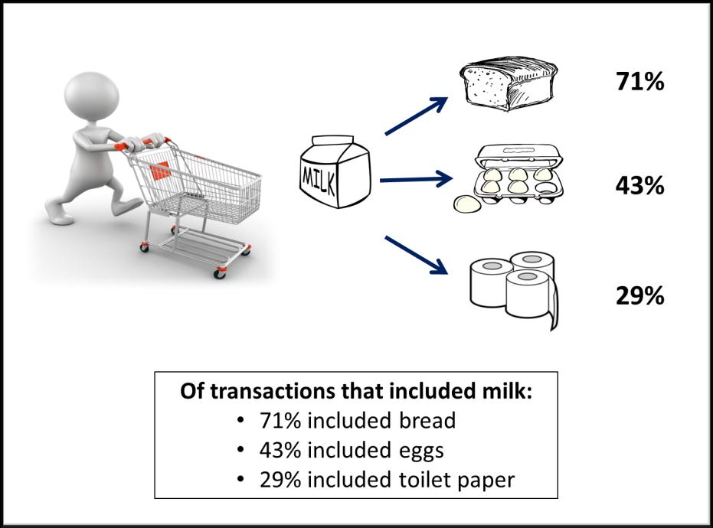
How Data Mining Works
Data mining builds models to identify patterns among variables in the dataset.
Models are the mathematical representations that identify the patterns among the attributes of the objects:
Simple linear relationships.
Complex highly nonlinear relationships.
Four major types of patterns:
Associations:
Find the commonly co-occurring groupings
of things.
E.g., beer and diapers going together in
market-basket analysis.

Slide 17

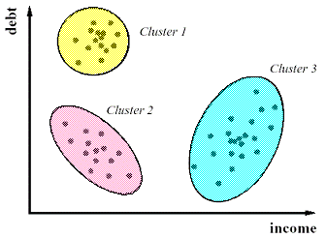
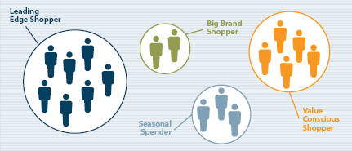
How Data Mining Works (cont.)
Predictions:
Tell the nature of future occurrences of certain events based on what has happened in the past.
E.g., predicting the winner of the Super Bowl or forecasting
the absolute temperature of a particular day.
Clusters:
Identify natural groupings of things based on their known characteristics.
E.g., assigning customers in different segments
based on their demographics and past purchase
behaviors.

Slide 18
How Data Mining Works (cont.)
Sequential relationships:
Discover time-ordered events, i.e., time series.
E.g., predicting that an existing banking customer who already has a checking account will open a savings account followed by an investment account within a year.

Slide 19
Taxonomy for Data Mining Tasks
Data mining tasks can be classified into three main categories of prediction, association and clustering.
Learning algorithms of data mining methods can be classified according to the way patterns are extracted from historical data:
Supervised learning method – Training data include both:
Descriptive attributes – Independent variables or decision variables.
Class attributes – Output variable or result variable.
Unsupervised learning method – Training data include only the descriptive attributes.

Slide 20
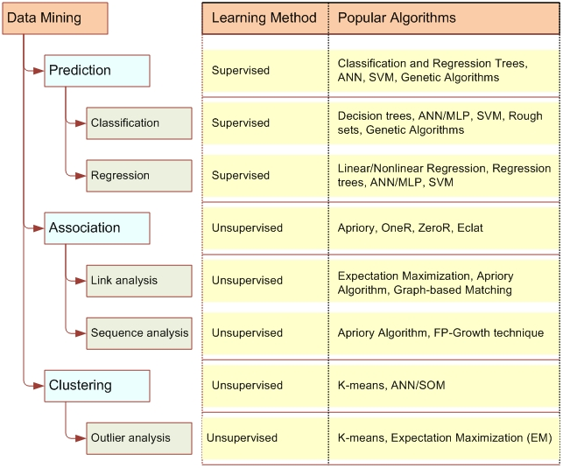
Taxonomy for Data Mining Tasks (cont.)

Slide 21
Prediction
Two main types of prediction depending on the nature of what is being predicted.
Classification:
The predicted thing is a class label.
E.g., tomorrow’s weather forecast such as “rainy” or “sunny”.
Regression:
The predicted thing is a real number.
E.g., tomorrow’s temperature is “33°C”.
More about classification:
Also known as supervised induction and is a very common data mining task.

Slide 22
Prediction (cont.)
Objective is to analyze historical data stored in database and automatically generate a model that can accurately predict actual future events:
Model consists of generalizations over the records of the training dataset to help distinguish predefined classes.
Model is then used to predict the classes of other unclassified records.
Common classification tools include:
Machine learning – Neural networks, decision trees and support vector machines.
Traditional statistics – Logistic regression and discriminant analysis.

Slide 23
Regression Analysis

Slide 24

Learning Objectives
At the end of this lecture, you should understand:
Structure of regression models.
Simple linear regression.
Multiple linear regression.
Validation of regression models.
Selection of predictive variables.
Treatment of categorical variables.

Slide 25
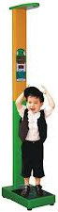
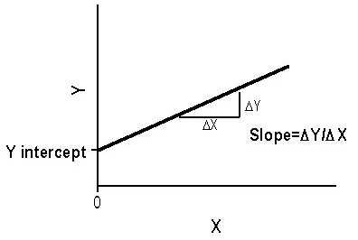
Overview of Regression Analysis
In data mining, we are interested to predict the value of a target variable from the value of one or more explanatory variables.
Example – Predict a child’s weight based on his/her height.
Weight is the target variable.
Height is the explanatory variable.
Regression analysis builds statistical models that characterize relationships among numerical variables.
Two broad categories of regression models:
Cross-sectional data – Focus of this lecture.
Time-series data – Focus of Day 3.
Independent variables are time or some function of time.

Slide 26
Structure of Regression Models
Purpose of regression models is to identify functional relationship between the target variable and a subset of the remaining variables in the data.
Goal of regression models is twofold:
Highlight and interpret dependency of the target variable on other variables.
Predict the future value of the target variable based upon the functional relationship identified and future value of the explanatory variables.
Target variable is also known as dependent, response or output variable.
Explanatory variable is also known as independent or predictory variables.

Slide 27
Structure of Regression Models
Suppose dataset D composed of m observations, a target variable and n explanatory variables:
Explanatory variables of each observation may be represented by a vector in the n-dimensional space ^{n}.
Target variable is denoted by .
The m vectors of observation is written as a matrix having dimension m x n.
Target variable is written as
Let be the random variable representing the target attribute and , the random variables associated with the explanatory variables.

Slide 28
Structure of Regression Models (cont.)
Regression models conjecture the existence of a function f: ^{n} →  that expresses the relationship between the target variable and the n explanatory variables :

Slide 29
Linear Regression Models
If we assume that the functional relationship f: ^{n} →  is linear:
we have linear regression models.
This assumption may be restrictive but most nonlinear relationships may be reduced to a linear one by applying appropriate preliminary transformation:
A quadratic relationship of the form
can be linearized through the transformation into a
linear relationship with two explanatory variables:

Slide 30
Linear Regression Models (cont.)
An exponential relationship of the form
can be linearized through a logarithmic transformation ,
which converts it into the linear relationship:
A simple linear regression model of the form:
may be visualized as:

Slide 31
Simple Linear Regression
Bivariate linear regression models a random variable Y as linear function of another random variable X:
is a random variable, referred to as error, which indicates the discrepancy between the response Y and the prediction
.
When the regression coefficients are determined by minimizing the sum of squared errors SSE, must follow a normal distribution with 0 mean and standard deviation :

Slide 32
Simple Linear Regression (cont.)
The preceding model is known as simple linear regression where there is only one explanatory variable.
When there are multiple explanatory variables, the model would be a multiple linear regression model of the form:

Slide 33
Simple Linear Regression (cont.)
For a simple linear regression model of the form:
given the data samples
The error for the prediction is:
The regression coefficients and can be computed by the method of least squares which minimizes the sum of the squared errors SSE:

Slide 34
Simple Linear Regression (cont.)
To find the regression coefficients and that minimize SSE:

Slide 35
Example of Simple Linear Regression
Predict a child’s weight based on height:
The dataset contains 19 observations.
There are four variables altogether – Name, Weight, Height and Age.
Note that for linear regression, we are using both Scikit Learn and StatsModels.
StatsModels provide more summary statistics as compared to Scikit Learn.
We could also manually calculate the required statistics...

Slide 36
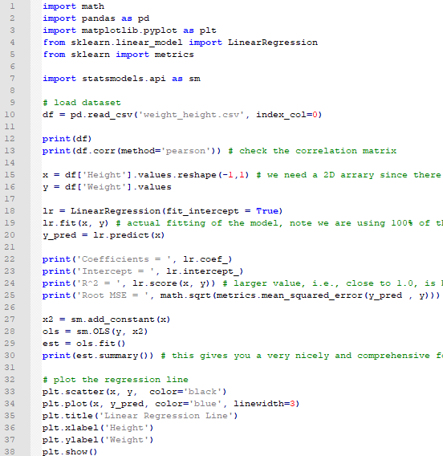
Example of Simple Linear Regression (cont.)

Slide 37
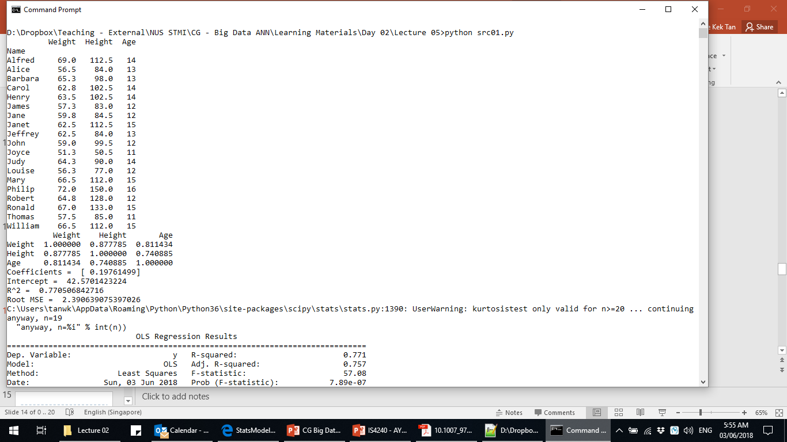
Example of Simple Linear Regression (cont.)
Scikit Learn’s output

Slide 38
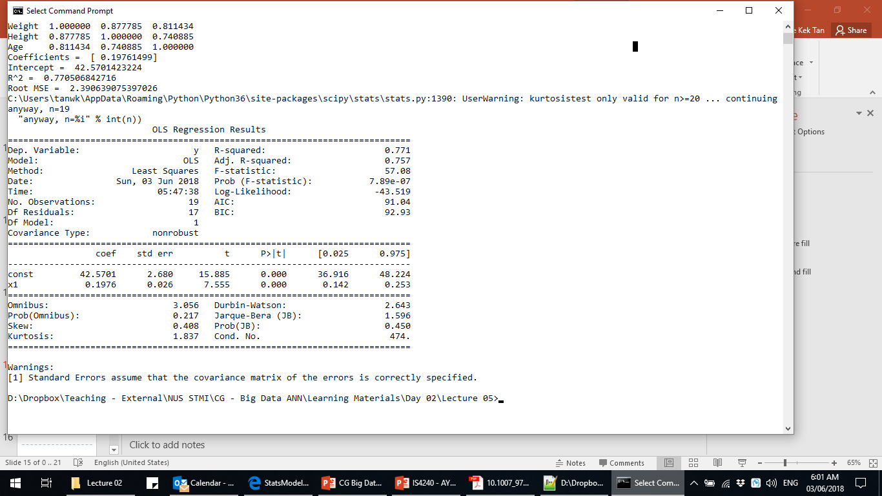
Example of Simple Linear Regression (cont.)
StatsModels’ output

Slide 39
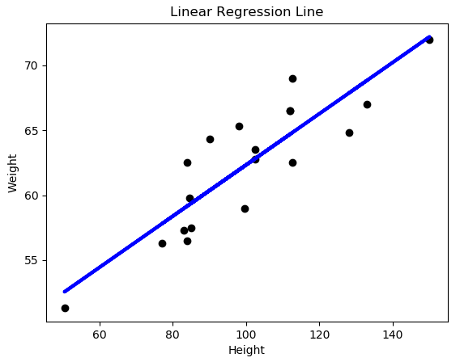
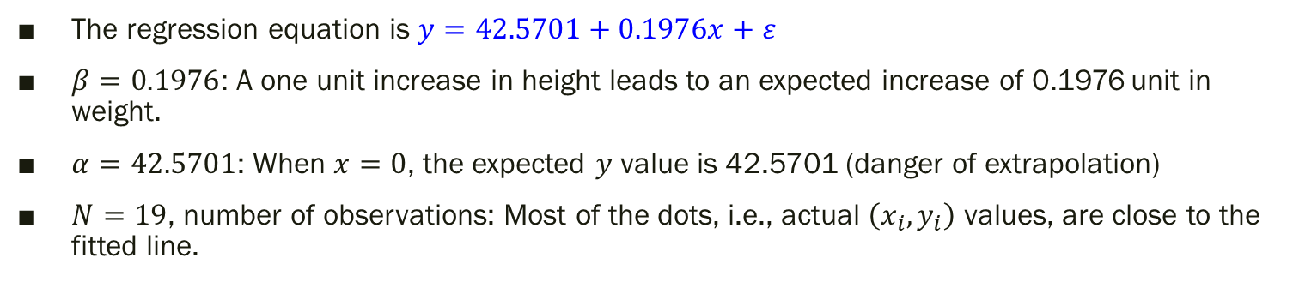
Example of Simple Linear Regression (cont.)
The regression equation is $y=42.5701+0.1976x+ε$
$β=0.1976$: A one unit increase in height leads to an expected increase of 0.1976 unit in weight.
$α=42.5701$: When $x=0$, the expected $y$ value is 42.5701 (danger of extrapolation)
$N=19$, number of observations: Most of the dots, i.e., actual $\left(x_{i},y_{i}\right)$ values, are close to the fitted line.

Slide 40
Validation of Model – Coefficient of Determination
R-Square = = 0.7705: 77.05% of the variation in is explained by the model:
This value is the proportion of total variance explained by the predictive variable(s):

Slide 41
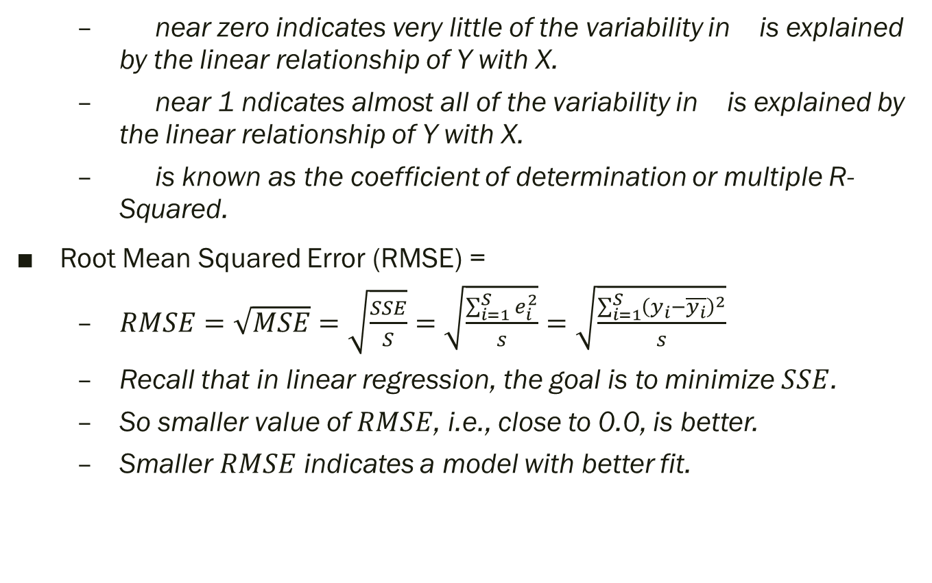
Validation of Model – Coefficient of Determination
near zero indicates very little of the variability in is explained by the linear relationship of Y with X.
near 1 ndicates almost all of the variability in is explained by the linear relationship of Y with X.
is known as the coefficient of determination or multiple R-Squared.
Root Mean Squared Error (RMSE) =
$RMSE=\sqrt{MSE}=\sqrt{\frac{SSE}{S}}=\sqrt{\frac{\sum_{i=1}^{S}{e_{i}^{2}}}{s}}=\sqrt{\frac{\sum_{i=1}^{S}{{\left(y_{i}−\overline{y_{i}}\right)}^{2}}}{s}}$
Recall that in linear regression, the goal is to minimize $SSE$.
So smaller value of $RMSE$, i.e., close to 0.0, is better.
Smaller $RMSE$ indicates a model with better fit.

Slide 42
Validation of Model – Coefficient of Determination (cont.)
DF Model = 1, only one independent variable in this model
DF Corrected Total = S-1=18, because
Knowing 18 of them, we will know the value of the 19th difference.
Analysis of Variance
F-value = MSE_{Model}/MSE_{Error} = 57.08
F-value has n and m-n-1 DF
The corresponding p-value is < .0001, indicating that at least one of the independent variables is useful for predicting the dependent variable.
In this case, there is only 1 independent variable: the value of height is useful for predicting the value of weight.

Slide 43
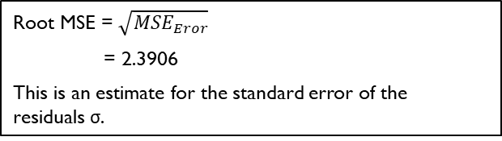
Validation of Model – Coefficient of Determination (cont.)
R-Square = Model MS/Corrected Total SS
= 0.771
77.1% of the variance in weight can be explained by the simple linear model with height as the independent variable.
Adjusted R-Square = 0.757
= 1 – (1 – R²) (m – 1)/(m – n – 1)
= 1 – (1 – 0.771)(19-1)/
(19 – 1 – 1)
= 0.757
R-Square always increases when a new term is added to a model, but adjusted R-Square increases only if the new term improves the model more than would be expected by chance.
Root MSE = $\sqrt{{MSE}_{Eror}}$
= 2.3906
This is an estimate for the standard error of the
residuals σ.

Slide 44
Validation of Model – Significance of Coefficient of Determination
Is the value of β significantly different from zero?
Hypothesis test:
The t-value for the test is (0.1976/0.026) = 7.555 with corresponding p-value of < 0.0001.
Since the p-value is lower than 5%, we may conclude with 95% confidence to reject that β is 0.
Note for simple linear regression models: t-value of the β parameter is the square root of the F-value. In this example, 7.555× 7.555 ≈ 57.08

Slide 45
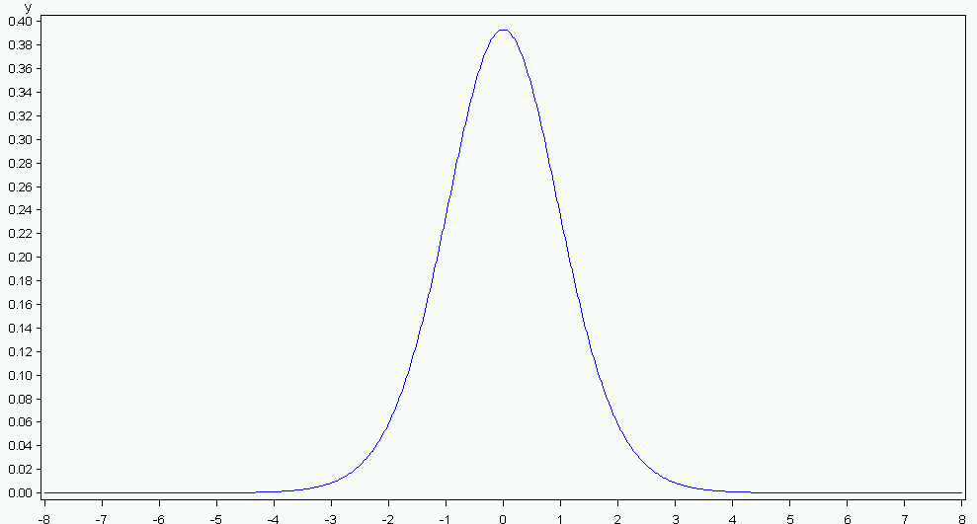
Validation of Model – Significance of Coefficient of Determination (cont.)
The area under the curve to the left of -7.555 and to the right of +7.555 is less than 0.0001.
We reject the null hypothesis and conclude that the slope β is not 0, i.e. the variable height is useful for predicting the dependent variable weight.

Slide 46
Validation of Model – Coefficient of Linear Correlation
In a simple linear regression model, the coefficient of determination = the squared of the coefficient of linear correlation between X and Y.
In our example: X = Height; Y = Weight
r = 0.877785
R² = 0.7705 ≈ 0.771

Slide 47
Evaluating the Assumptions of Linear Regression
Linearity:
Relationship between the independent and dependent variables is linear.
The linearity assumption can best be tested with scatter plots.
Recall the scatter and line plot of the linear regression line that we have created earlier.
The $\left(x_{i},y_{i}\right)$ values appear to be linear.

Slide 48
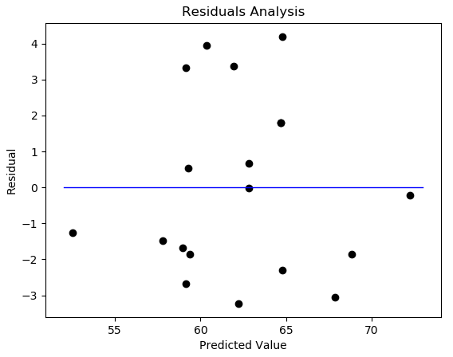
Evaluating the Assumptions of Linear Regression (cont.)
Homoscedasticity:
Residuals are equal across the regression line.
Scatter plots between residuals and predicted values are used to confirm this assumption.
Any pattern would result in a violation of this assumption and point toward a poor fitting model.
In the child’s weight example, no regular pattern/trend is observed.

Slide 49
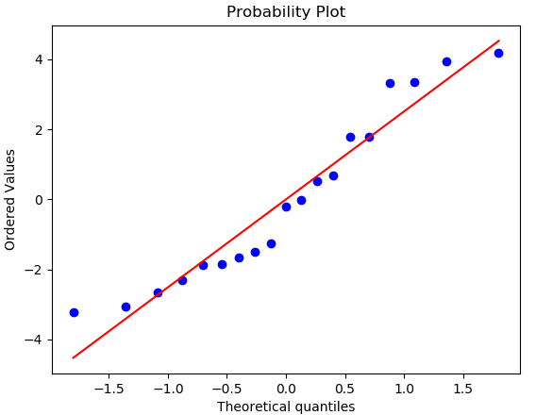
Evaluating the Assumptions of Linear Regression (cont.)
We can also check the normality of the residuals using a Q-Q plot..
QQ plot of the residuals in the child’s weight example.
Data points must fall (approximately) on a straight line for normal distribution.

Slide 50
Evaluating the Assumptions of Linear Regression (cont.)
Auto-correlation:
Residuals must be independent from each other.
Residuals are randomly distributed with no pattern in the scatter plot.
We can also use the Durbin-Watson test to test the null hypothesis that the residuals are not linearly auto-correlated:
While d can assume values between 0 and 4, values around 2 indicate no autocorrelation.
As a rule of thumb values of 1.5 < d < 2.5 show that there is no auto-correlation in the data.
StatsModels’ will report the Durbin-Watson’s d value, which is 2.643 in the child’s weight example.

Slide 51
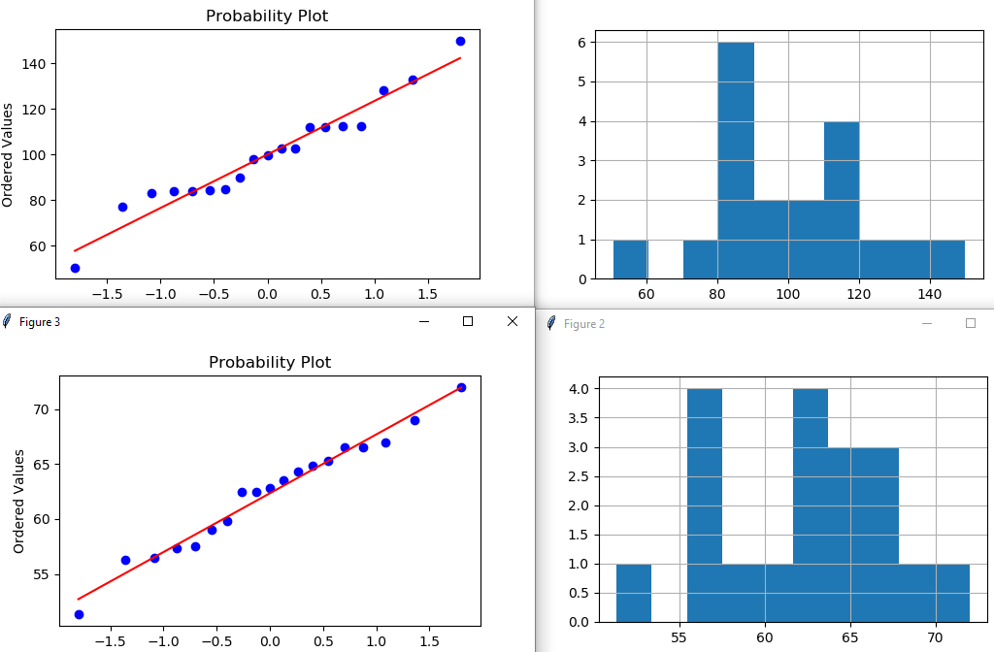
Evaluating the Assumptions of Linear Regression (cont.)
Multivariate normality:
All variables in the linear regression model are normally distributed on a univariate level.
We can perform visual/graphical test to check for normality of the data using Q-Q plot and also histogram.
Top (left to right) – Q-Q plot and histogram of Height.
Bottom (left to right) – Q-Q plot and histogram of Weight.

Slide 52
Evaluating the Assumptions of Linear Regression (cont.)
No or little multicollinearity:
Independent variables are not correlated with each other.
For simple linear regression, this is obviously not a problem ☺
We will revisit the multicollinearity assumption in the multiple linear regression model.
Child’s weight example:
We may conclude that the residuals are normal and independent.
The linear regression model fits the data well.

Slide 53
Multiple Linear Regression
A multiple linear regression model is of the form:
may be visualized as:
The regression coefficient expresses the marginal effect of the variable on the target, conditioned on the current value of the remaining predictive variables.
Scale of the values influences the value of the corresponding regression coefficient and thus it might be useful to standardize the predictive variables.

Slide 54
Multiple Linear Regression (cont.)
There are different techniques to standardize or normalize data:
Decimal scaling.
Min-max normalization.
z-index normalization.
MLR Scenario 1 – Product Sales and Advertisement Channels:
Relationship between product sales and investments made in advertisement through several media communication channels.
The regression coefficients indicate the relative advantage afforded by the different channels.

Slide 55
Multiple Linear Regression (cont.)
MLR Scenario 2 – Colleges and Universities Graduation Rate:
The source of the dataset is attributed to Evans (2013).
Predict the percentage of students who eventually graduate (GraduationPercent) using a set of 4 explanatory variables:
MedianSAT – Median SAT score of students.
AcceptanceRate – Acceptance rate of applicants.
ExpendituresPerStudent – Education budget per student.
Top10PercentHS – % of students in the top 10% of their high school

Slide 56
Example of Multiple Linear Regression
Predict ccolleges and universities graduation rate:
Predicting the percentage of students accepted into a college program whom would eventually graduate:
The dataset contains 49 observations.
There are five possible independent variables altogether – Type, MedianSAT, AcceptanceRate, ExpendituresPerStudent, Top10PercentHS.
For now, we will only use the latter four numerical variables, i.e., excluding Type.

Slide 57
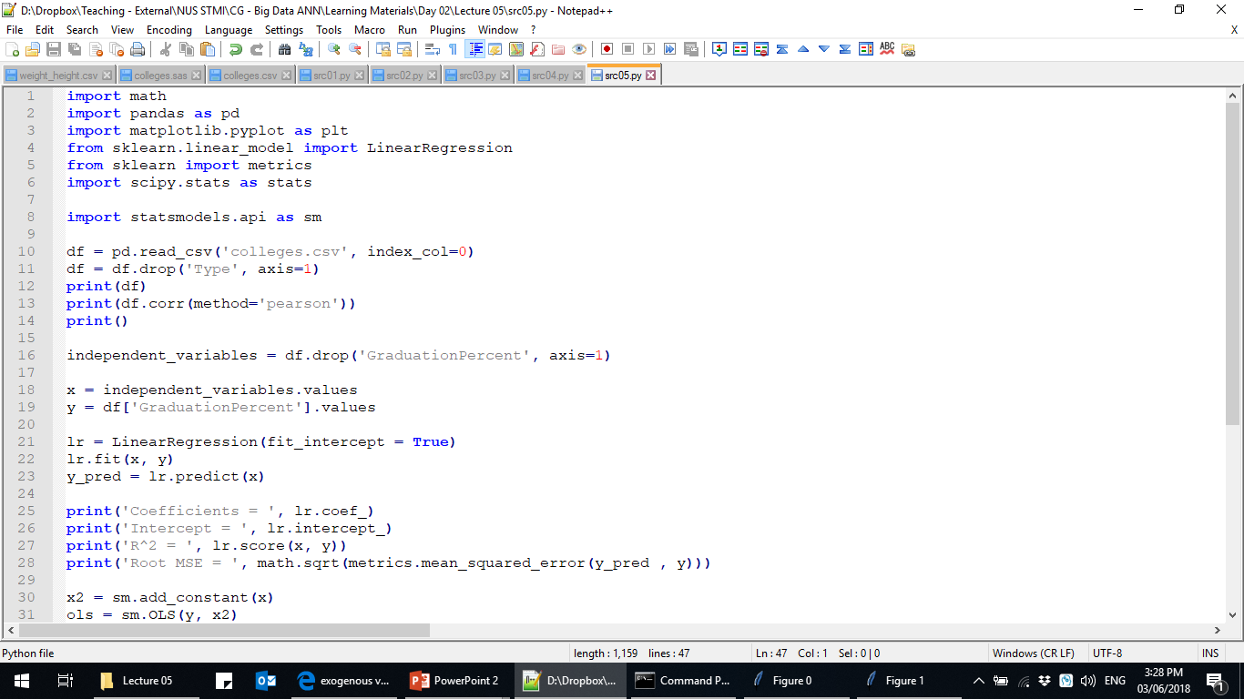
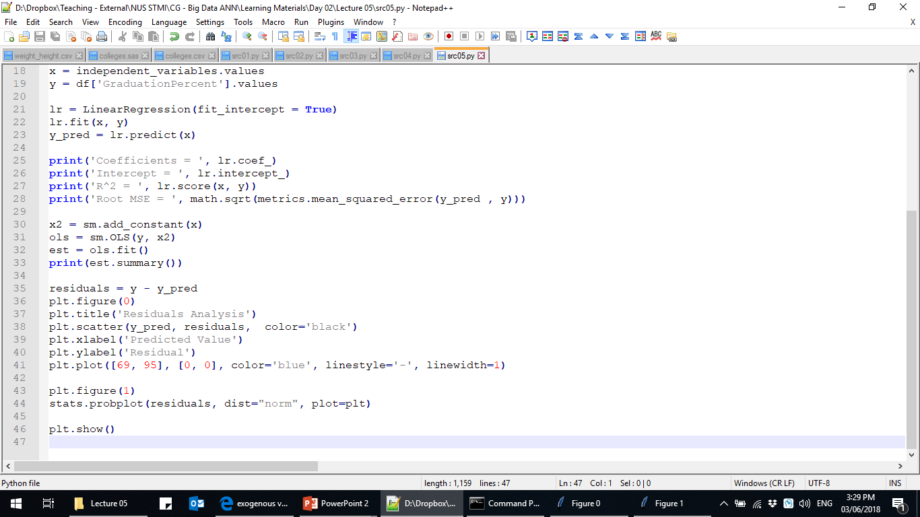
Example of Multiple Linear Regression (cont.)

Slide 58
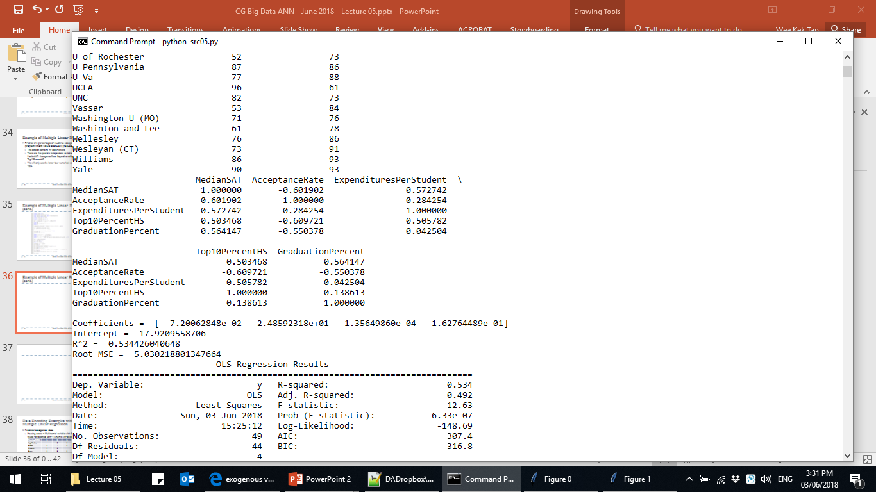
Example of Multiple Linear Regression (cont.)
Scikit-Learn’s output
Top: Correlation matrix.
Bottom: Regression model

Slide 59
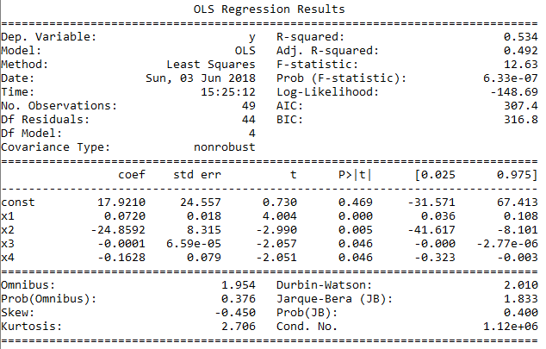
Example of Multiple Linear Regression (cont.)
StatsModels’ output

Slide 60
Example of Multiple Linear Regression (cont.)
The regression equation is:
GraduationPercent = 7.92096 + 0.0720×MedianSAT – 24.8592×AcceptanceRate – 0.0001×ExpendituresPerStudent – 0.16278×Top10PercentHS
Interpreting the regression coefficients:
Higher median SAT scores and lower acceptance rates suggest higher graduation rates.
1 unit increase in median SAT scores increase graduation rates by 0.0720 unit, all other things being equal.
1 unit increase in acceptance rates decrease graduation rates by 24.8592 unit, all other things being equal.

Slide 61
Example of Multiple Linear Regression (cont.)
Overall:
Do the regression coefficients make sense?
R² and Adjusted R² are quite similar.
R² is only 0.53.
RMSE is 5.03

Slide 62
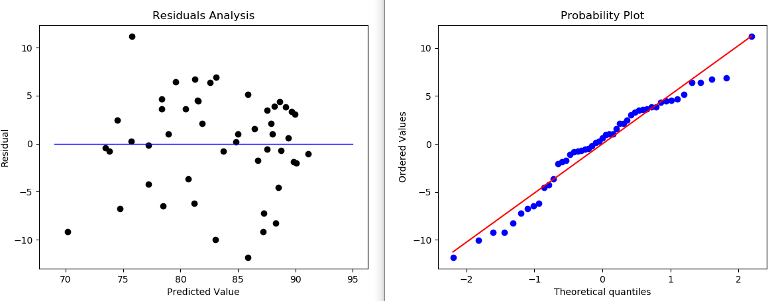
Evaluating the Assumptions of Linear Regression
Residuals analysis:
The scatter plot of residuals against predicted values and the Q-Q plot of the residuals shows that the residuals are normal and independent.
See the sample script src05.py line 35 to 46.

Slide 63
Evaluating the Assumptions of Linear Regression (cont.)
Multicollinearity:
Occurs when significant linear correlation exists between two or more predictive variables.
Potential problems:
Regression coefficients are inaccurate.
Compromises overall significance of the model.
Possible that the coefficient of determination is close to 1 while the regression coefficients are not significantly different from 0.
Pairwise linear correlation coefficients may be calculated.

Slide 64
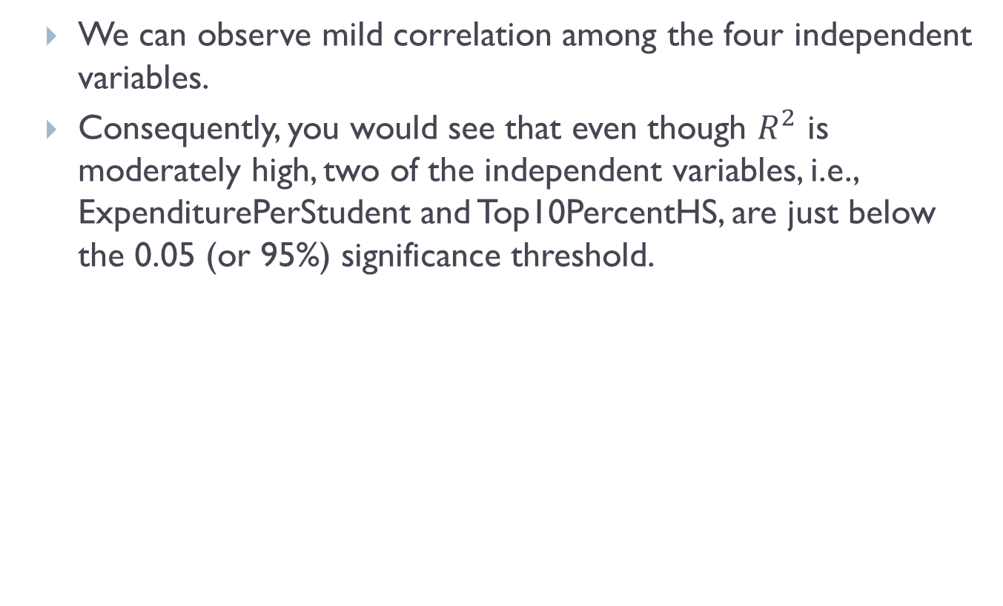
Evaluating the Assumptions of Linear Regression (cont.)
We can observe mild correlation among the four independent variables.
Consequently, you would see that even though $R^{2}$ is moderately high, two of the independent variables, i.e., ExpenditurePerStudent and Top10PercentHS, are just below the 0.05 (or 95%) significance threshold.

Slide 65
Evaluating the Assumptions of Linear Regression (cont.)
To identify multiple linear relationships or multicollinearity among predictive variables:
Calculate the variance inflation factor (VIF) for each predictor as:
where is the coefficient of determination for the
model that explains , treated as a response, through
the remaining independent variables.
indicates multicollinearity.

Slide 66
Selection of Predictive Variables
In multiple linear regression model:
We typically select a subset of all predictive variables that are most effective in explaining the response variable.
Relevance analysis identifies variables that do not contribute to the prediction process.
This is known as feature selection.
Rationales:
Model based on all predictive variables may not be significant due to multicollinearity.
Model with too many variables tend to overfit the training data samples and they may not predict new/unseen data with good accuracy.

Slide 67
Selection of Predictive Variables (cont.)
General methods for variables selection:
Forward Selection – Starts with no variables in the model and adds variables using the F statistics.
Backward Elimination – Starts with all variables in the model and deletes variables using the F statistics.
Stepwise:
Similar to forward selection except the variables in the model do not necessarily stay there.
A hybrid of forward selection and backward elimination.
A variable that was initially added could be deleted if the addition of a new variable negatively affects its level of significance.

Slide 68
Selection of Predictive Variables (cont.)
However, variables selection suffers from some potential problems:
May introduce bias in the selection of variables.
May lack theoretical grounding on the final set of selected variables.
May require significant computing power, and thus time, if the dataset is large.
Variables selection with Scikit Learn:
Does NOT support variables selection in its linear regression routine.
Supports a standalone routine to calculate the F-score and pvalues corresponding to each of the regressors (sklearn.feature_selection.f_regression).

Slide 69
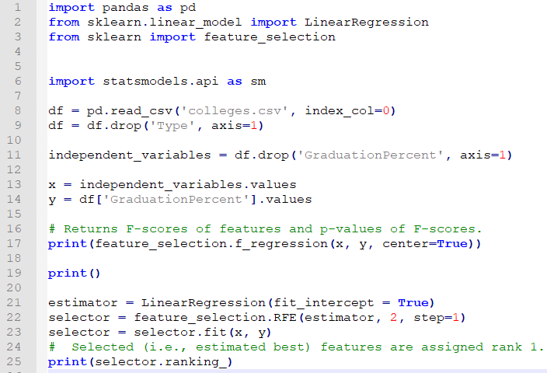
Selection of Predictive Variables (cont.)
Supports a standalone recursive feature elimination (sklearn.feature_selection.RFE).

Slide 70
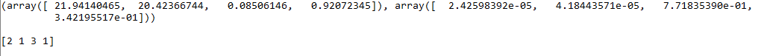
Selection of Predictive Variables (cont.)
Based on the F-scores, we would select MedianSAT and AcceptanceRate.
Based on the recursive elimination ranking, we would select MedianSAT and Top10PercentHS

Slide 71
Example of Variables Selection
Predict the newsprint consumption in US cities:
39 observations altogether.
Six independent variables:
X1: Number of newspaper in the city.
X2: Proportion of the city population under the age of 18.
X3: Median school year completed (city resident).
X4: Proportion of city population employed in white collar occupation.
X5: Logarithm of the number of families in the city.
X6: Logarithm of total retail sales.

Slide 72
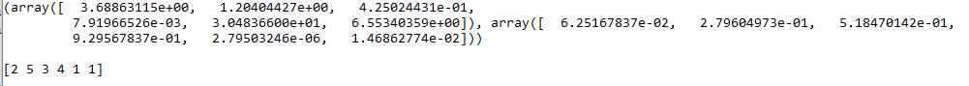
Example of Variables Selection (cont.)
Based on the F-scores, we would select X5 and X6.
Based on the recursive elimination ranking, we would select X5 and X6.

Slide 73
Treatment of Categorical Predictive Variables
Categorical variables may be included as predicators in a regression model using dummy variables.
A nominal categorical variable with distinct values denote by may be represented in two ways:
Using arbitrary numerical values:
Regression coefficients will be affected by the chosen scale.
Compromises significance of the model.
Using binary variables , called dummy variables
Each binary variable is associated with level of .
takes the value of if .

Slide 74
Data Encoding Examples with Multiple Linear Regression
Nominal categorical data:
Housing estate – Multinomial variable with 5 different possible values represented using 4 binomial variables I₁ to I₄:
Predict price of HDB flats (y) based on the size (x₁), floor level (x₂) and distance to MRT station (x₃).
Model:
In East Coast, the model is actually:
Housing Estate | I₁ | l₂ | l₃ | l₄
Ang Mo Kio | 1 | 0 | 0 | 0
Bishan | 0 | 1 | 0 | 0
Clementi | 0 | 0 | 1 | 0
Dover | 0 | 0 | 0 | 1
East Coast | 0 | 0 | 0 | 0

Slide 75
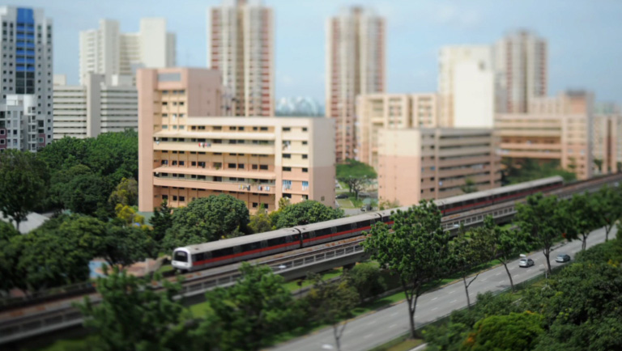
Data Encoding Examples with Multiple Linear Regression (cont.)
In Dover, the model is:
Suppose : The price of a HDB flat in Dover is expected to be $12000 less than another HDB flat in East Coast if both HDB flats have the same size, are on the same level and have the same distance to the nearest MRT station.
Interpretation of the dummy variables always with respect to East Coast.

Slide 76
Data Encoding Examples with Multiple Linear Regression (cont.)
Ordinal categorical data:
Education level – Multinomial variable with 4 different possible values represented using 3 binomial variables I₁ to I₃:
Predict starting salary (y) based on education level.
Model:
Suppose : No difference in starting salary.
Education Level | I₁ | l₂ | l₃
Elementary School | 0 | 0 | 0
High School | 0 | 0 | 1
College | 0 | 1 | 1
Graduate School | 1 | 1 | 1

Slide 77
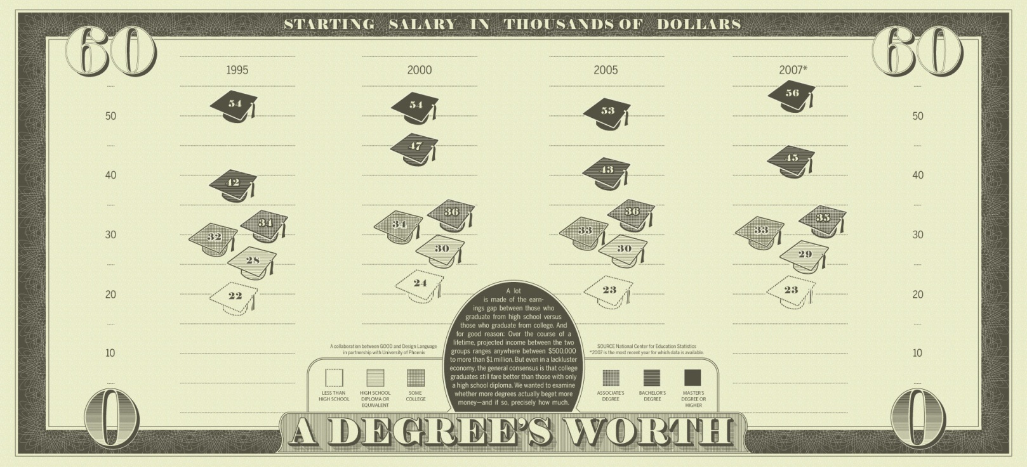
Data Encoding Examples with Multiple Linear Regression
Suppose :
Model:
When education level is high school or lower,
When education level is college or higher,

Slide 78
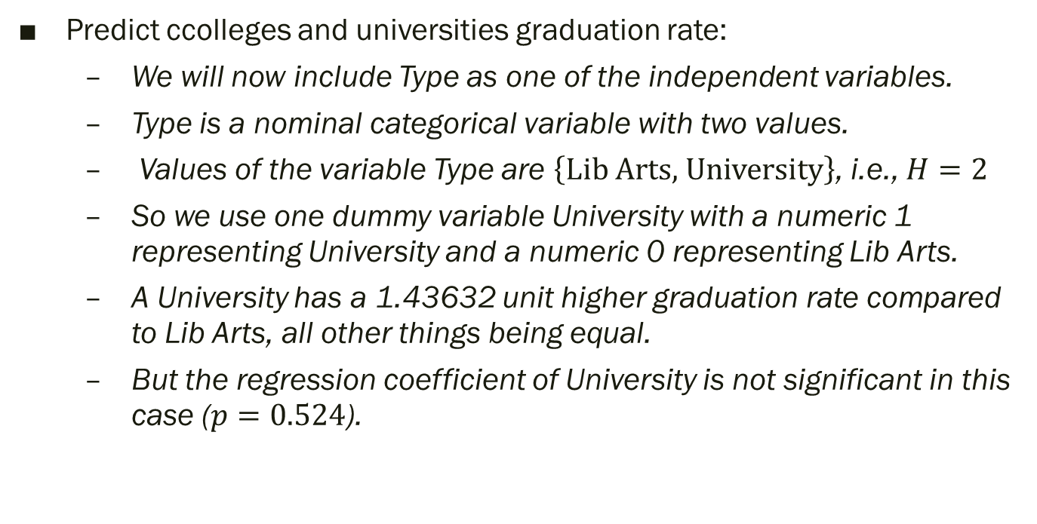
Example of Categorical Predictive Variables
Predict ccolleges and universities graduation rate:
We will now include Type as one of the independent variables.
Type is a nominal categorical variable with two values.
Values of the variable Type are $\left\{\text{Lib} \text{Arts}\text{, }\text{University}\right\}$, i.e., $H=2$
So we use one dummy variable University with a numeric 1 representing University and a numeric 0 representing Lib Arts.
A University has a 1.43632 unit higher graduation rate compared to Lib Arts, all other things being equal.
But the regression coefficient of University is not significant in this case ($p=0.524$).

Slide 79
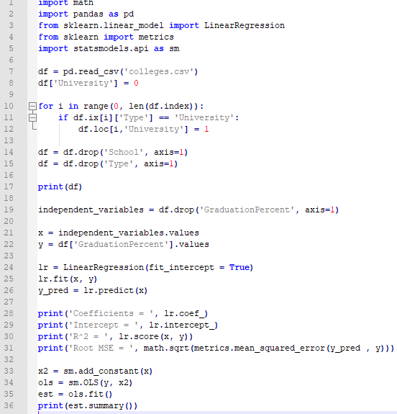
Example of Categorical Predictive Variables (cont.)
Dummy coding of “University” from line 8 to 12

Slide 80
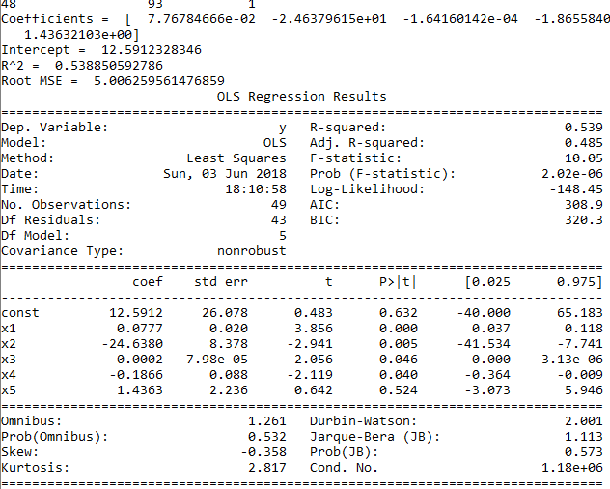
Example of Categorical Predictive Variables (cont.)

Slide 81
Clustering
Partitions a collection of things into segments (or natural groupings).
Members in the same segment share similar characteristics.
Unsupervised method in which the class labels are unknown.
Clusters are established through a more complex process:
Commonalities of things are identified based on their characteristics using a heuristic-type algorithm.
Different algorithms may create different clusters from the same dataset.

Slide 82
Clustering (cont.)
An expert may be required to interpret and modify the suggested clusters before actual use.
Reasonable clusters are then used to classify and interpret new data.

Slide 83
Classification versus Clustering – A Concrete Example
The Zoo dataset from Weka consists of 101 observations of animals:
Name of the animal, i.e., the identifier.
Type of the animal, i.e., the class label:
7 types – Mammal, bird, reptile, fish, amphibian, insect and invertebrate.
A set of variables describing the characteristics of each animal:
15 Boolean-valued variables such as hair, feathers, eggs and milk.
1 numeric-valued variable, i.e., number of legs (0 to 8).

Slide 84
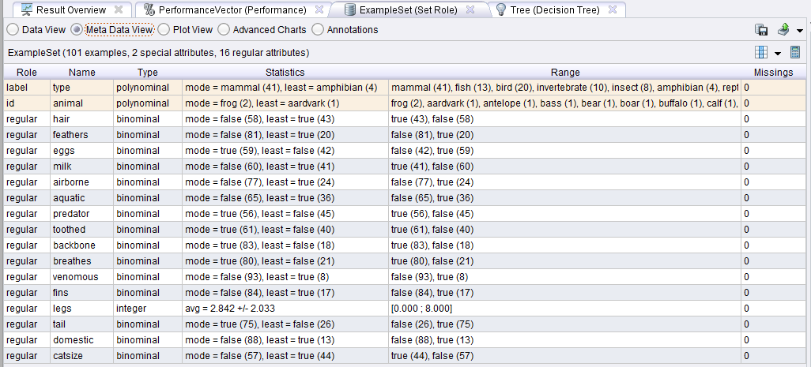
Classification versus Clustering – A Concrete Example

Slide 85
Classification versus Clustering – A Concrete Example (cont.)
Classification:
Uses decision tree analysis, a machine learning technique.
Learn the function between the characteristics of animals and their membership to each type.
Supervised learning process.
Uses a common two-step methodology – Model development/training and model testing/deployment:
70% of sample is used to train the model and derive a decision tree.
30% of sample is used to test the model.
Compute the predictive accuracy, i.e., the model’s ability to correctly predict the class label of new or previously unseen data.
In this example, the predictive accuracy is 90%.

Slide 86
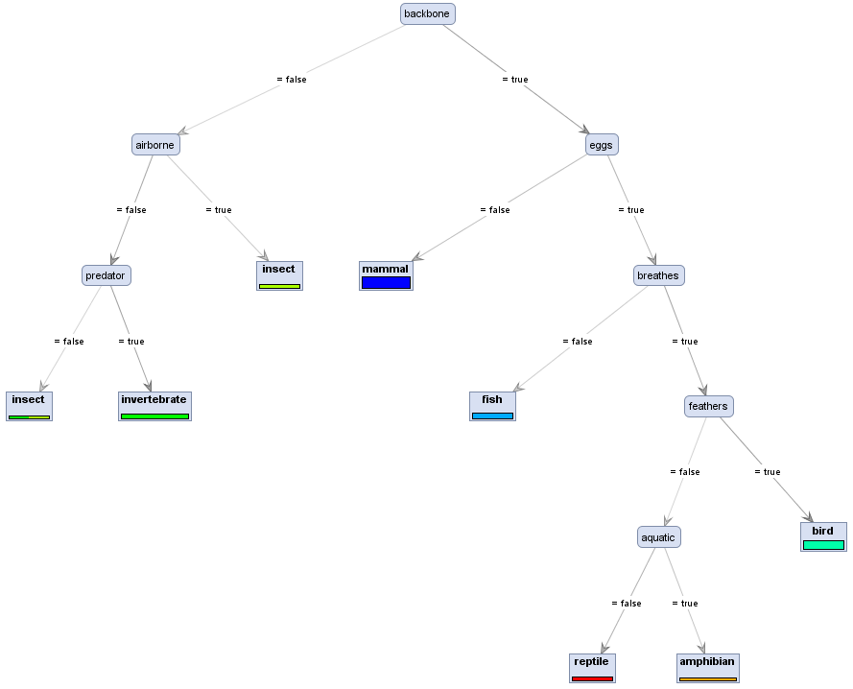
Classification versus Clustering – A Concrete Example (cont.)
This decision tree is derived from the 70% training data sample. It gives a predictive accuracy of 90% when applied to the 30% test or holdout sample.

Slide 87
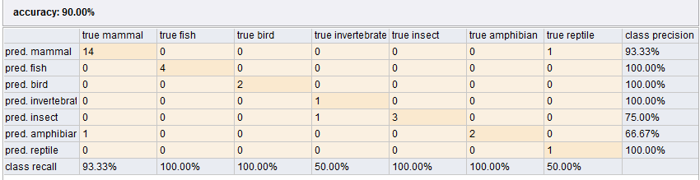
Classification versus Clustering – A Concrete Example (cont.)

Slide 88
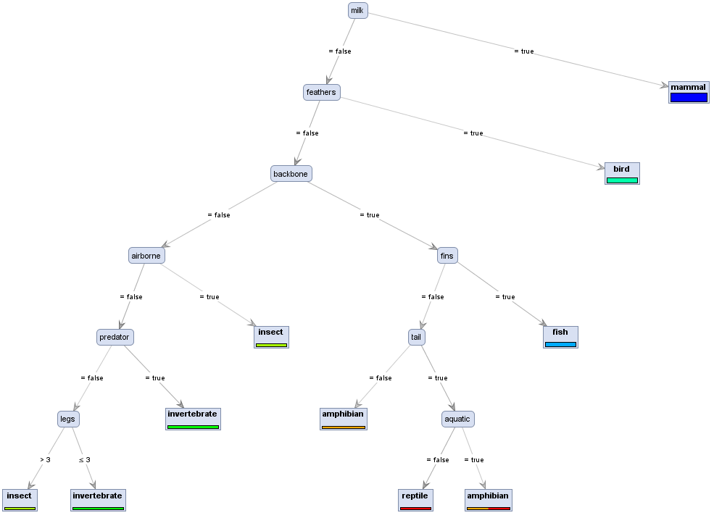
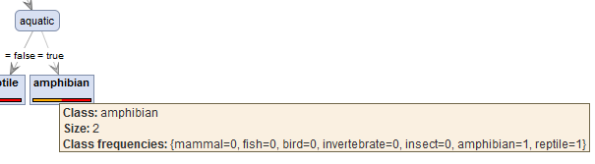
Classification versus Clustering – A Concrete Example (cont.)
This decision tree is derived from the entire sample dataset. Not surprising, this decision tree should have a higher predictive accuracy but may not be 100%.

Slide 89
Classification versus Clustering – A Concrete Example (cont.)
Clustering:
Uses k-means clustering algorithm, a traditional statistical analysis technique.
A predetermined number of clusters is defined, denoted by k.
The algorithm assigns each data point (in this case each animal) to the cluster whose center, i.e., centroid, is the nearest:
Centroid is calculated as the average of all the points in the cluster.
Coordinates of the centroid are the arithmetic mean for each dimension separately over all the points in the cluster.
Unsupervised learning process – The class label, i.e., animal type, is not used by the algorithm.
In this example, we use k=2 and k=7 for comparison.

Slide 90
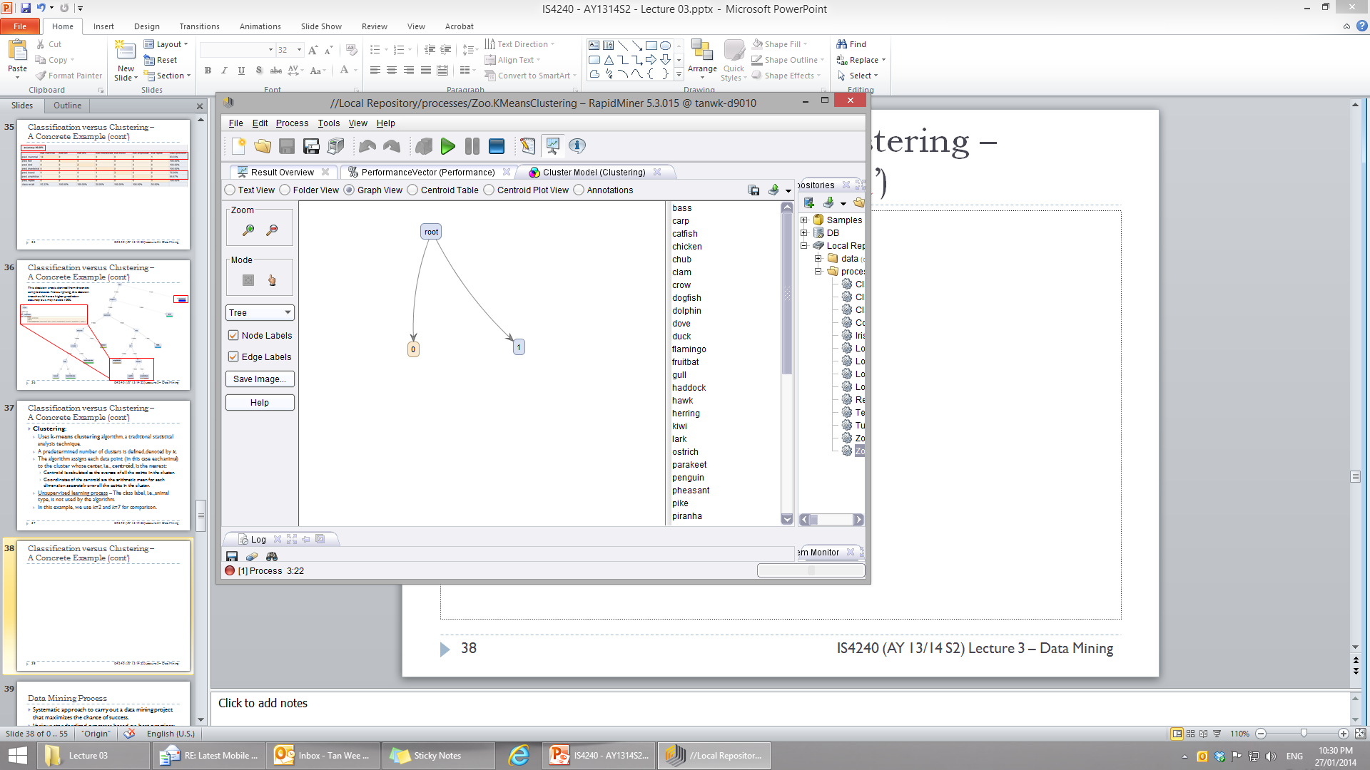
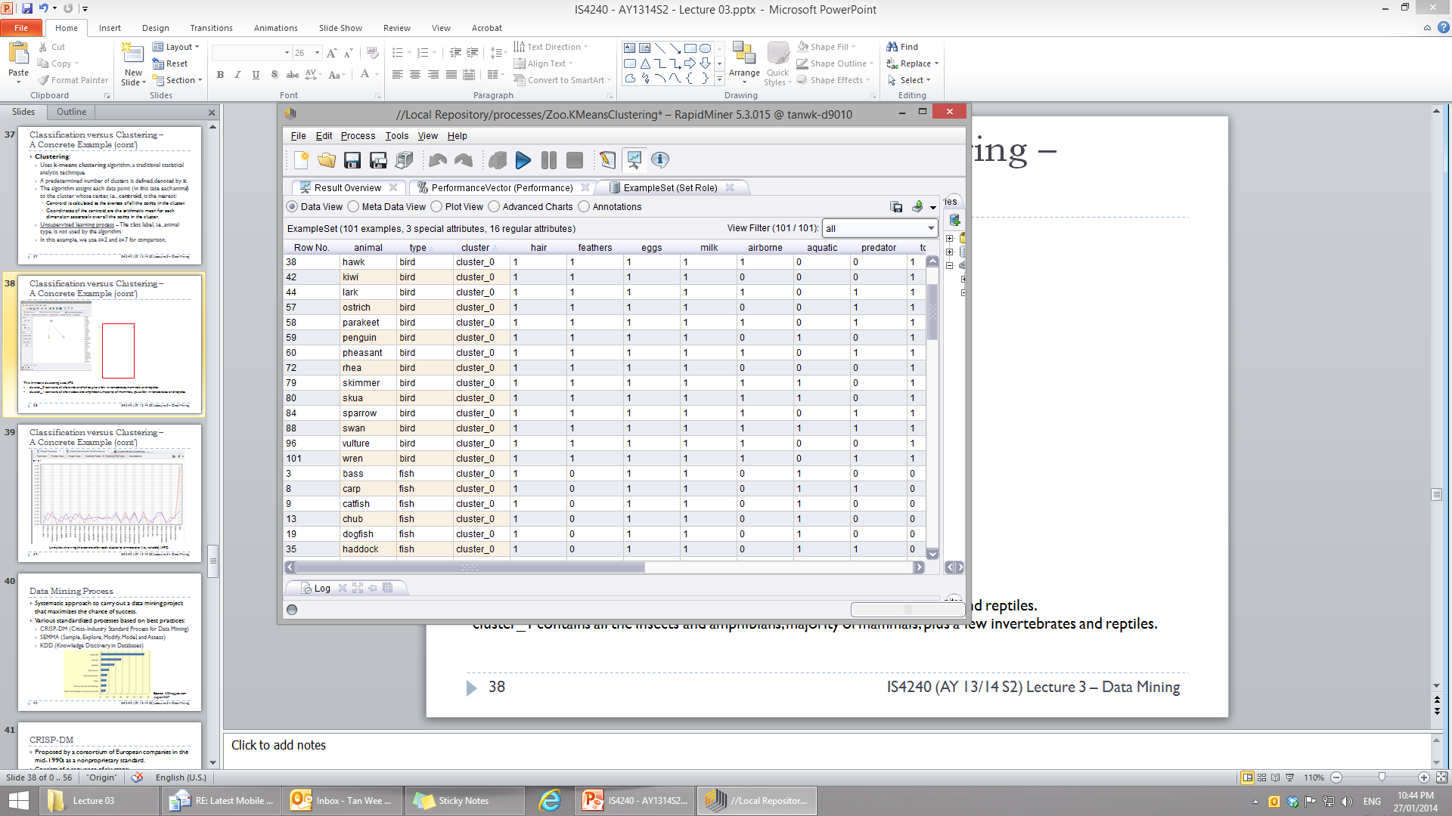
Classification versus Clustering – A Concrete Example (cont.)
This k-means clustering uses k=2:
cluster_0 contains all the birds and fishes, plus a few invertebrates, mammals and reptiles.
cluster_1 contains all the insects and amphibians, majority of mammals, plus a few invertebrates and reptiles.
Note that all the Boolean-valued variables have been converted to numeric values so that the centroid can be calculated.

Slide 91
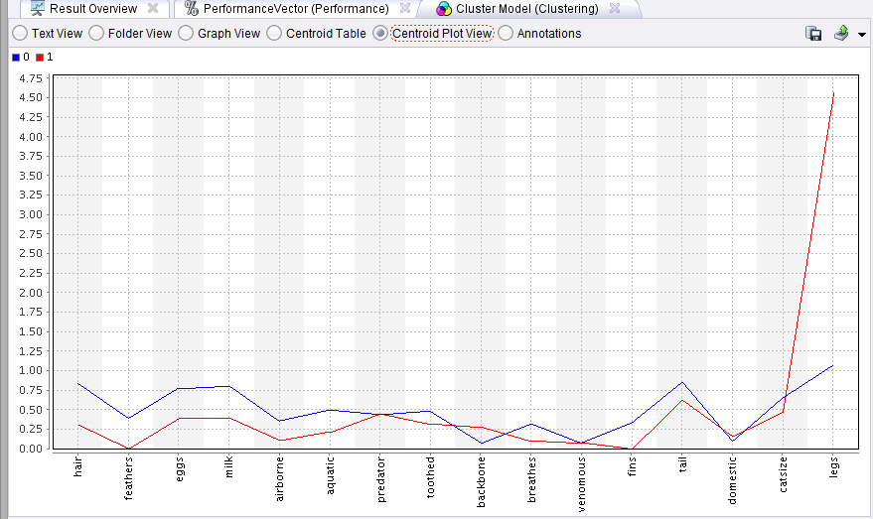
Classification versus Clustering – A Concrete Example (cont.)
Line plot showing the centroid for each cluster by dimensions (i.e., variable) (k=2)

Slide 92
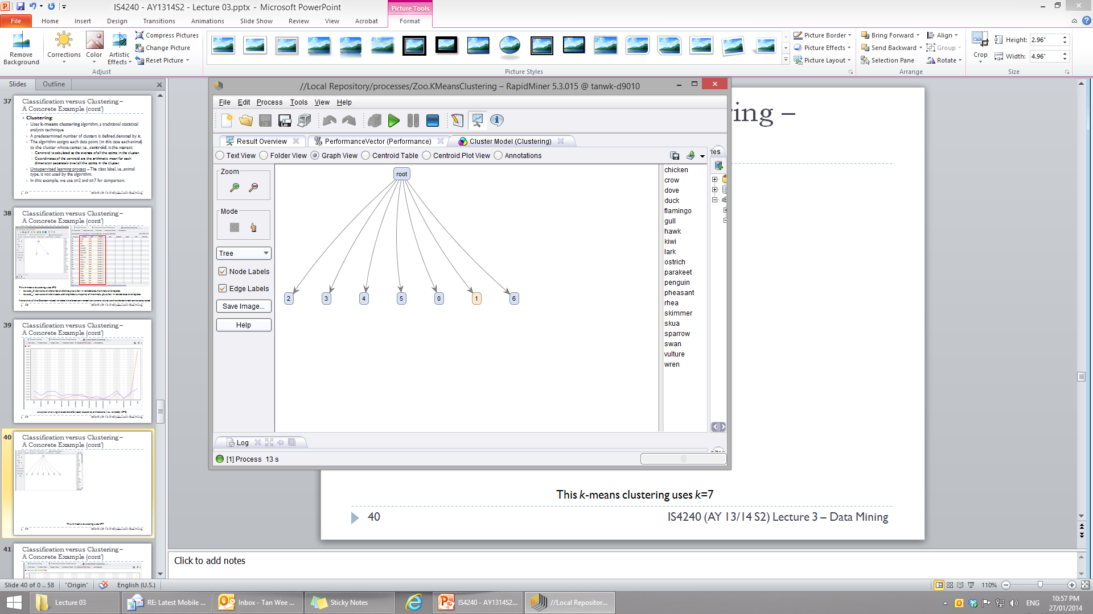
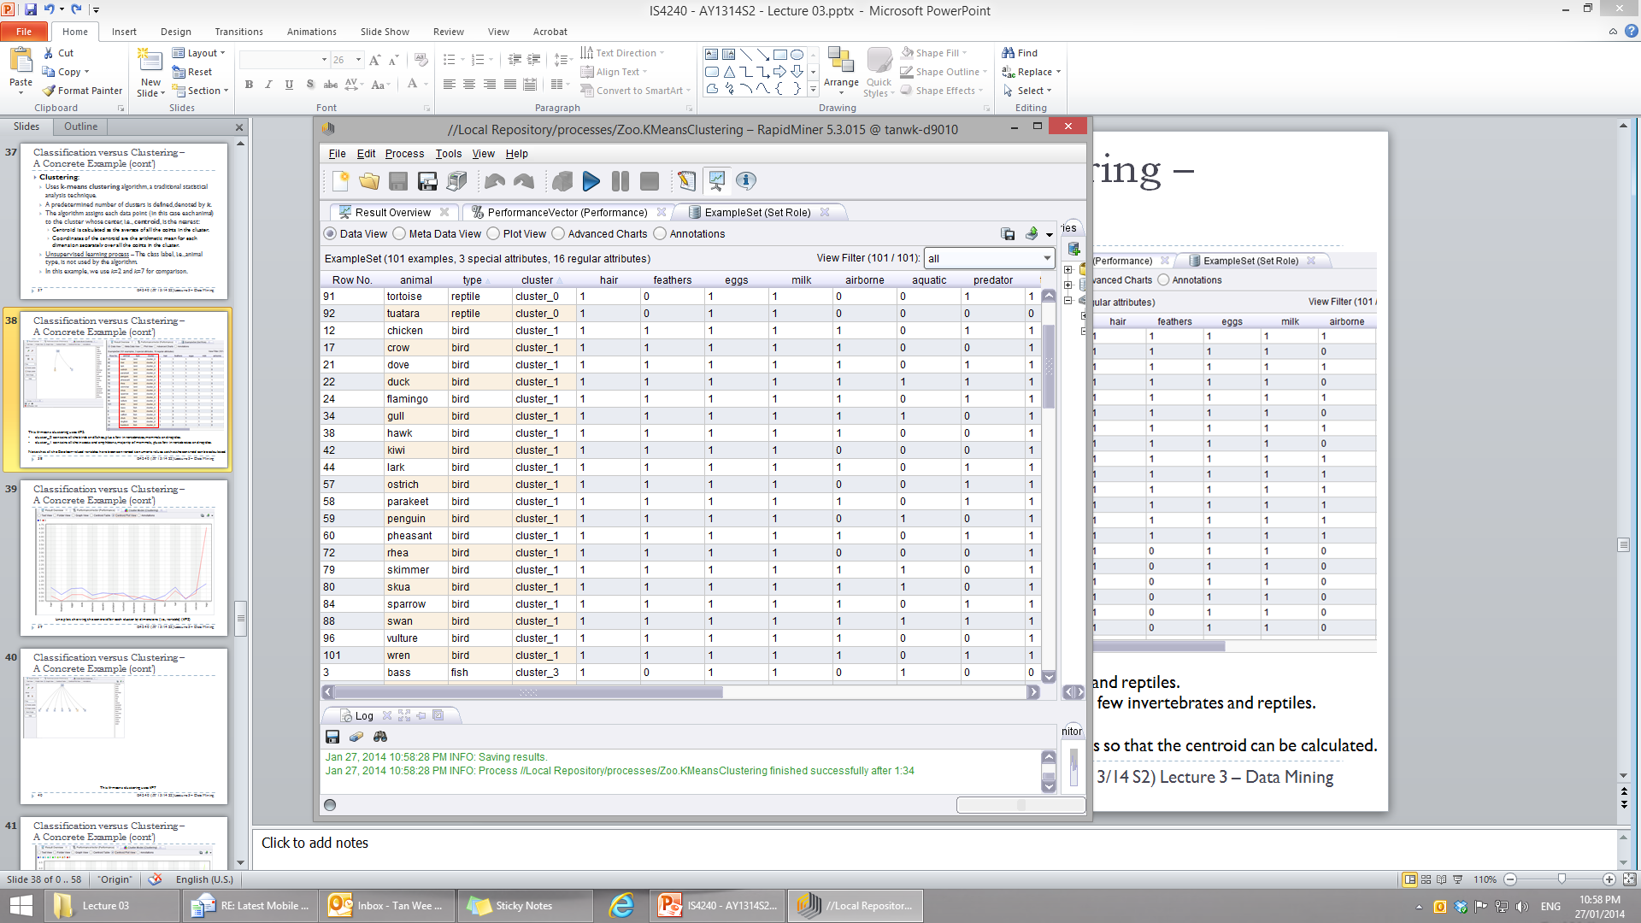
Classification versus Clustering – A Concrete Example (cont.)
This k-means clustering uses k=7:
cluster_1 contains all the birds only.
cluster_5 and cluster_6 contains only mammals, but there are a few mammals placed into cluster_3
Essentially, only cluster_1 “conforms to reality”, i.e., containing animal of a single type bird and no other clusters has a bird. Referring to the decision tree, one would see that a distinguishing characteristic of birds is that feather = true or 1. The centroid plot shows that the arithmetic mean of cluster_1 for feather is 1.0, much greater than all the other clusters, which is 0.0.

Slide 93
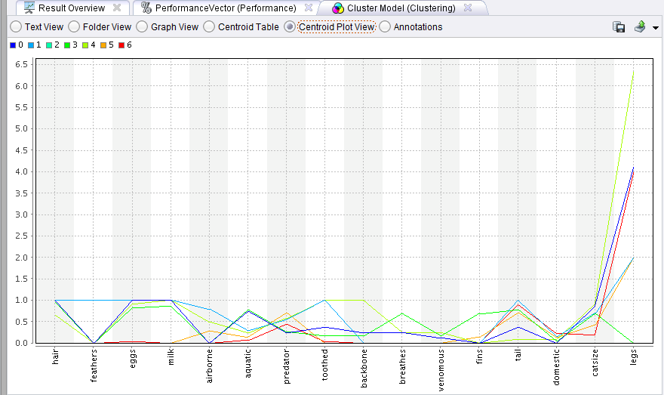
Classification versus Clustering – A Concrete Example (cont.)
Line plot showing the centroid for each cluster by dimensions (i.e., variable) (k=7)

Slide 94
Classification versus Clustering – A Concrete Example (cont.)
Cannot compute the predictive accuracy because we aren’t supposed to know the actual class label.
The quality of a clustering model is evaluated using other statistical measures.

Slide 95

Data Mining Goes to Hollywood
Decision situation – Predicting the box-office receipt (i.e., financial success) of a particular movie.
Problem:
Traditional approach:
Frames it as a forecasting (or regression) problem.
Attempts to predict the point estimate of a movie’s box-office receipt.
Sharda and Delen’s approach:
Convert into a multinomial classification problem.
Classify a movie based on its box-office receipts into one of nine categories, ranging from “flop” to “blockbuster”.
Use variables representing different characteristics of a movie to train various classification models.

Slide 96
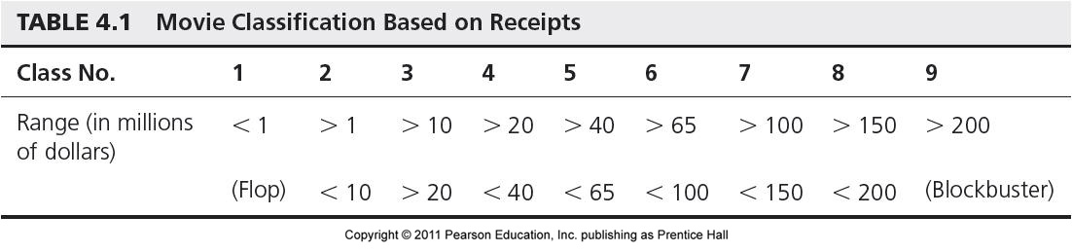
Data Mining Goes to Hollywood (cont.)
Proposed solution:
Dataset consists of 2,632 movies released between 1998 and 2006.
Training set – 1998 to 2005
Test set – 2006
Movie classification based on box-office receipts:

Slide 97
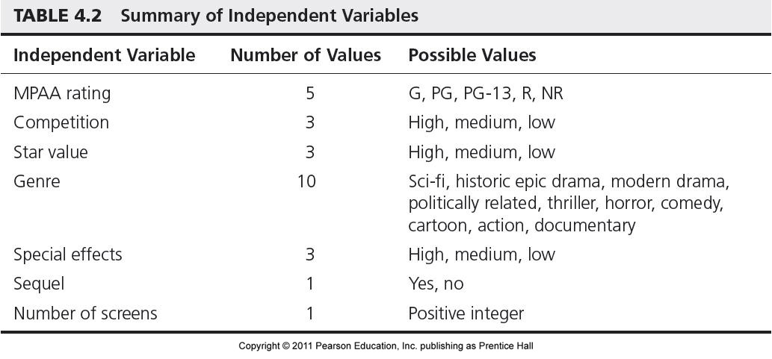
Data Mining Goes to Hollywood (cont.)
Independent variables:
A variety of data mining methods were used – neural networks, decision trees, support vector machines (SVM) and three types of ensembles.

Slide 98
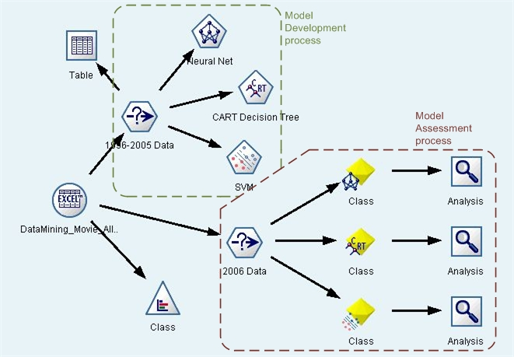
Data Mining Goes to Hollywood (cont.)
Data mining process map in IBM SPSS Modeler

Slide 99
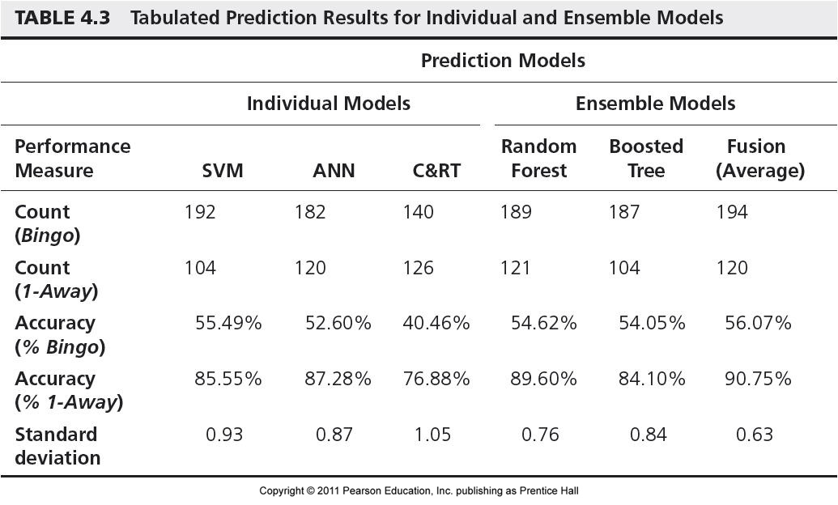
Data Mining Goes to Hollywood (cont.)
Results:

Slide 100
Data Mining Goes to Hollywood (cont.)
Performance measures:
Bingo – Percent correct classification rate.
1-Away correct classification rate – Within one category.
Among individual prediction models – SVM > ANN > CART
Ensemble models performed better than the individual prediction models:
Fusion algorithm being the best.
Ensemble models also have significantly low standard deviation compared to individual prediction models.

